Slide 1
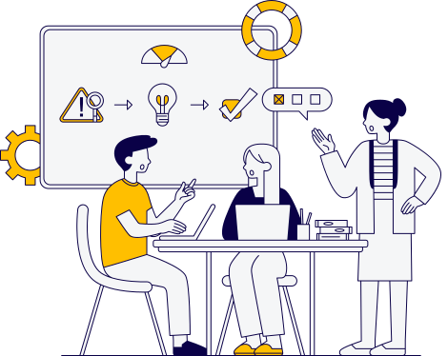

Aetherion
EVENTA X
A Collaborative Community Event Management System
BY:
Umer Khan
Hamza Imran
Inam Ullah Shaikh

Slide 2

Aetherion
Objectives
Interfaces
About
Complex Use Case
Sequence Diagram
3- tier Architecture
Component Diagram
Package Diagram
Deployment Diagram
GRASP Pattern
GOF Pattern
OVERVIEW

Slide 3

ABOUT EVENTAX
Aetherion
EventaX is a user-friendly system designed to manage and coordinate community events. It facilitates
event planning, scheduling, and resource allocation for local communities, organizations, and businesses.
The system streamlines event management by providing tools for booking venues, managing attendee
registrations, and coordinating resources.

Slide 4


Aetherion
OBJECTIVES
01
Event Creation and Scheduling
02
Venue Management
06
Dynamic Reporting and Analytics
03
Attendee Registration
07
Integrated Payment and Ticketing
04
Resource Coordination
05
08
Interactive Attendee Experience
Reporting and Notifications

Slide 5

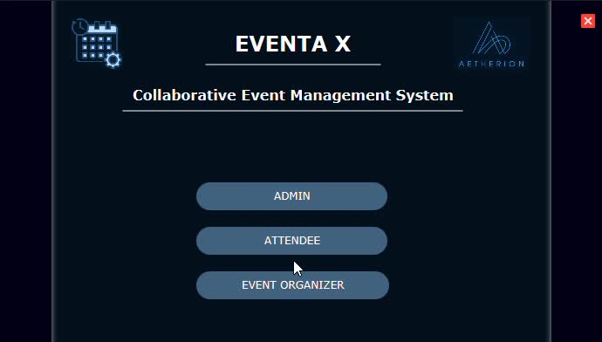
INTERFACES
Aetherion
HOME PAGE

Slide 6
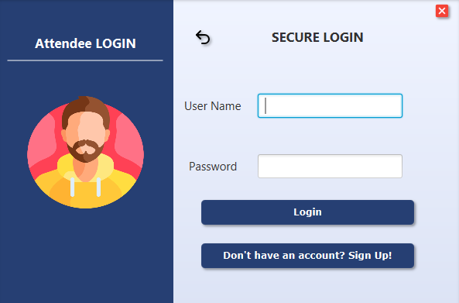
INTERFACES
Aetherion
LOGIN PAGE

Slide 7
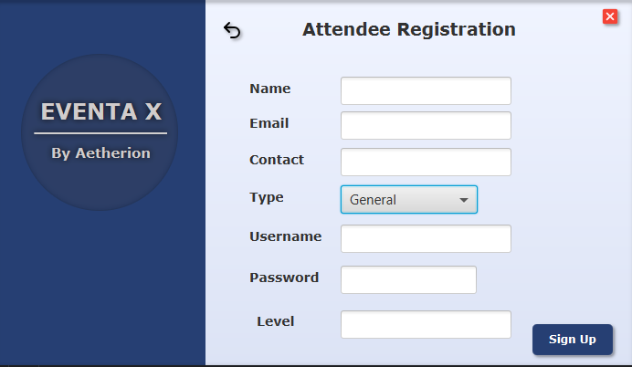
INTERFACES
Aetherion
REGISTRATION PAGE

Slide 8

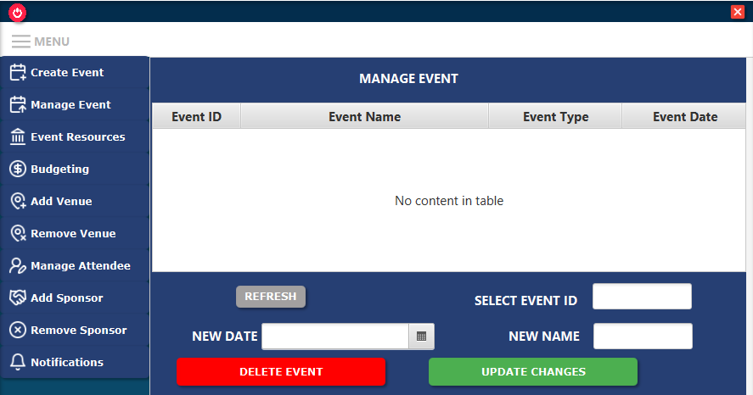
Aetherion
INTERFACES
MAIN PAGE

Slide 9

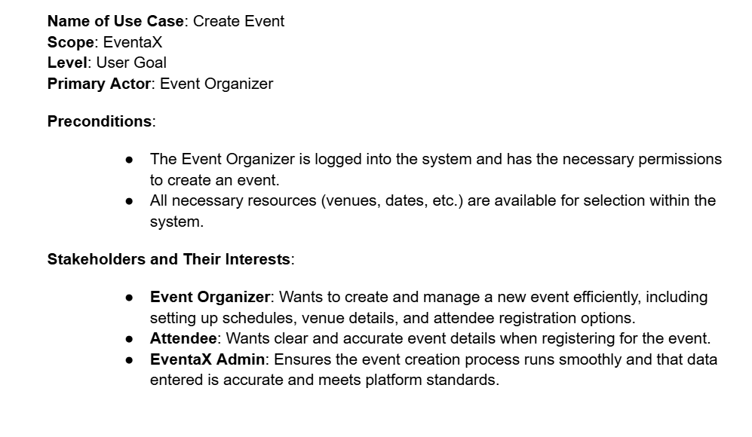
Aetherion
COMPLEX USE CASE

Slide 10
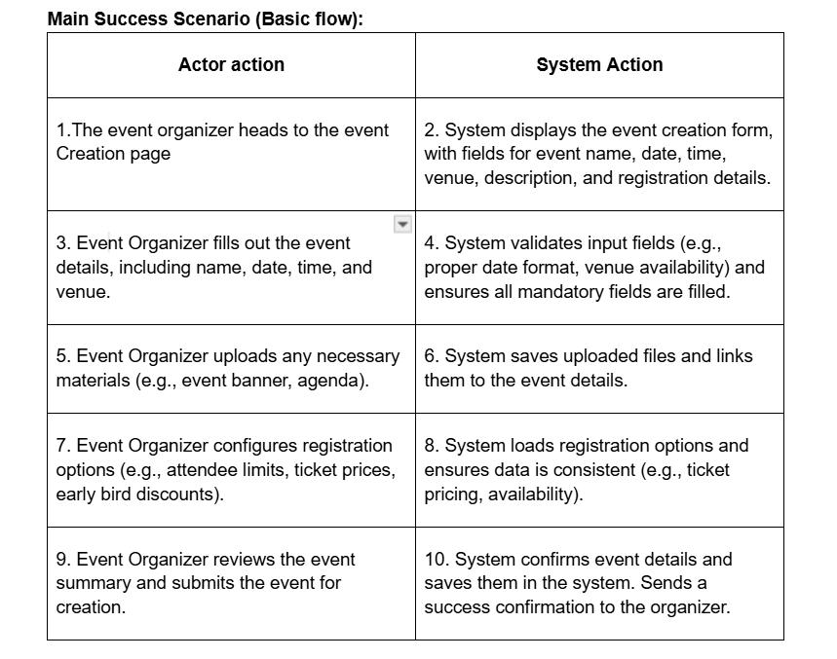
Aetherion
COMPLEX USE CASE

Slide 11
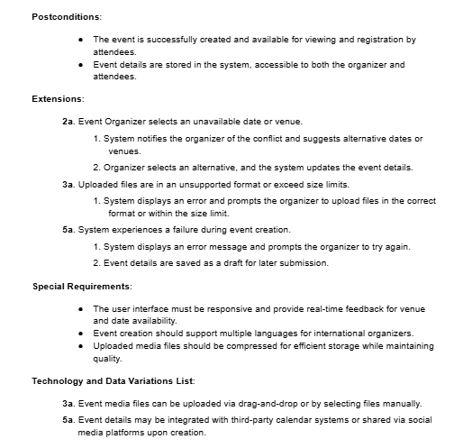
COMPLEX USE CASE
Aetherion

Slide 12
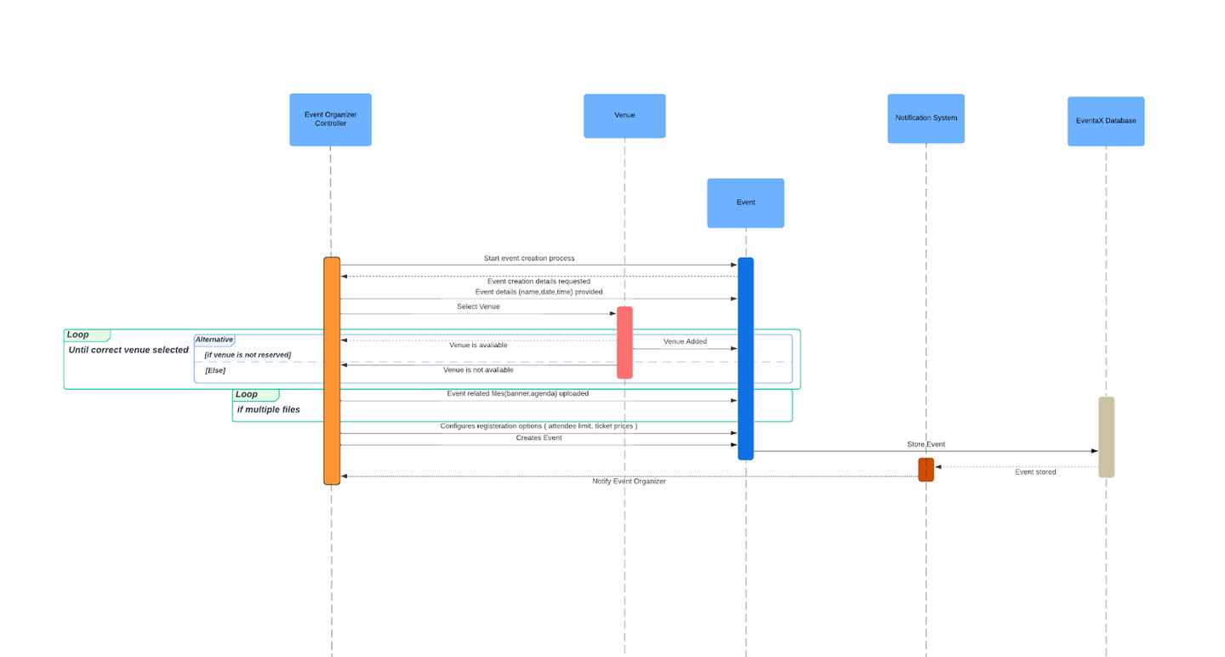

Aetherion
SEQUENCE DIAGRAM OF COMPLEX USE CASE

Slide 13
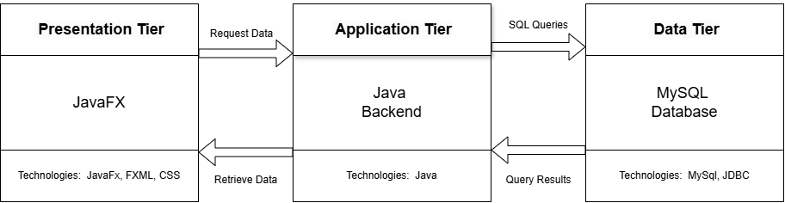
Aetherion
3 TIER ARCHITECTURE

Slide 14
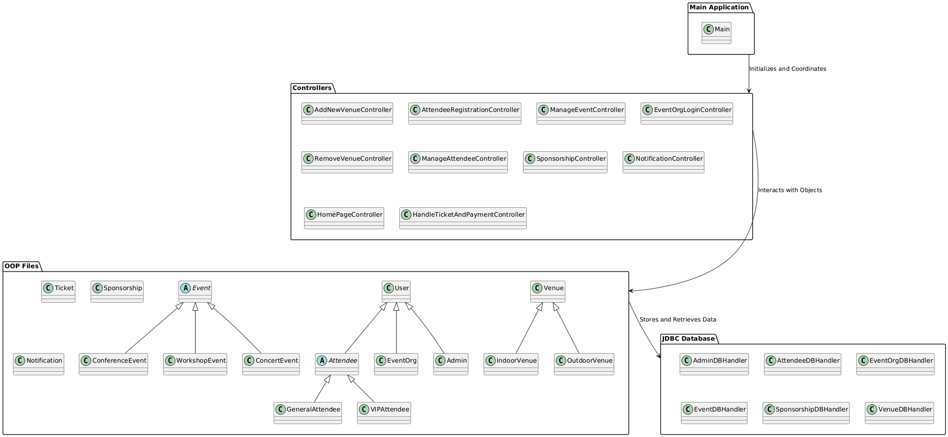
PACKAGE DIAGRAM
Aetherion

Slide 15
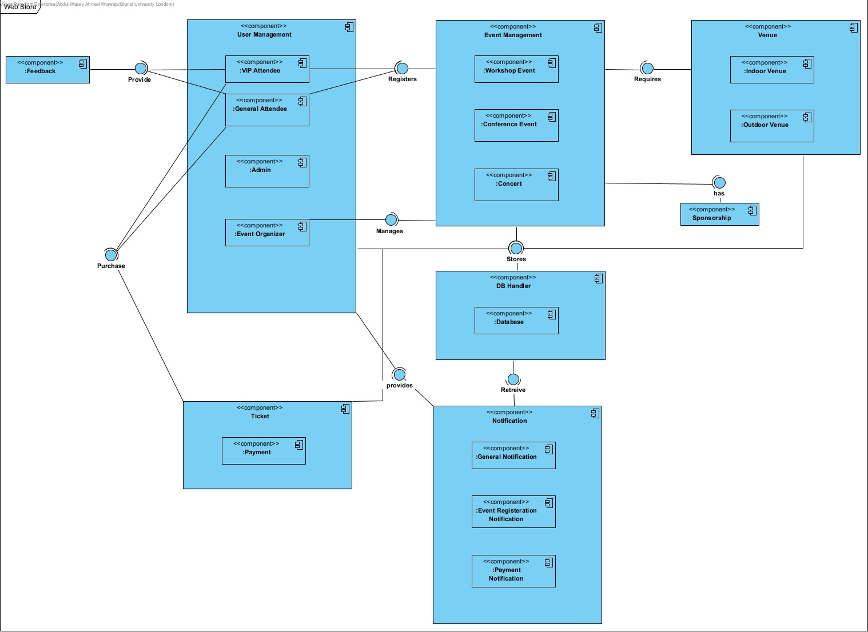
Aetherion
COMPONENT DIAGRAM

Slide 16
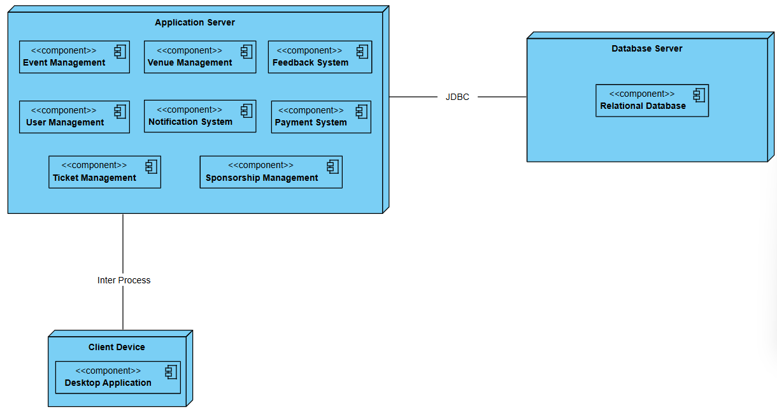
Aetherion
DEPLOYMENT DIAGRAM

Slide 17


GRASP PATTERN
Aetherion
01
LOW COUPLING
Keep dependencies between components minimal, such as separating event management, payment, and user handling modules.
02
HIGH COHESION
Assign responsibilities like managing attendee details, registrations, and updates directly to the Attendee class to maintain logical grouping.
03
INFORMATION EXPERT
Assign responsibilities to classes with the necessary information, e.g., the Event class handles event-specific details such as scheduling,
venue management, and managing event-related data
04
CONTROLLER
Use a controller class, like ManageAttendeeController, to handle user interactions and delegate tasks to the right objects.

Slide 18
Aetherion
05
PURE FABRICATION
Create a utility class, like NotificationService, for sending notifications, which doesn't map directly to a domain concept.
06
PROTECTED VARIATION
Encapsulate variations in user roles by creating a UserRole interface with specific implementations like AdminRole, AttendeeRole, and OrganizerRole, ensuring that changes in user roles don’t impact the core event management logic.
07
POLYMORPHISM
Use polymorphism to handle different venue types by creating a Venue interface, with IndoorVenue and OutdoorVenue classes implementing specific behaviors for setting up and managing the venue, allowing the system to treat them uniformly.
08
CREATOR
Ticket is the creator of Payment since Payment is composed within payment

Slide 19


GOF PATTERNS
Aetherion
01
FACTORY
User factory, Venue factory and Event factory are used for the creation of their respective objects.
02
OBSERVER
Notification Observer and Notification Service are used to send notifications to the all types of users (observers), by using a single unified function.
03
ADAPTER
Register Adapter is used to bridge the gap between the Attendee and Event Organizer registrations by calling appropriate registration function for the respective class.
04
SINGLETON
Each DB Handler is intialized once and used for the rest of the program's lifetime.

Slide 20

Aetherion
THANK YOU

